Slide 1
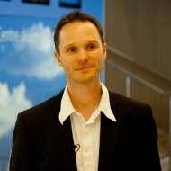
Serverless
Strom kommt aus der Steckdose und IT aus der Cloud
Rainer Stropek
software architects gmbh
Web
Mail
Twitter
http://www.timecockpit.com
rainer@timecockpit.com
@rstropek
Microservices

Slide 2
Why?

Slide 3
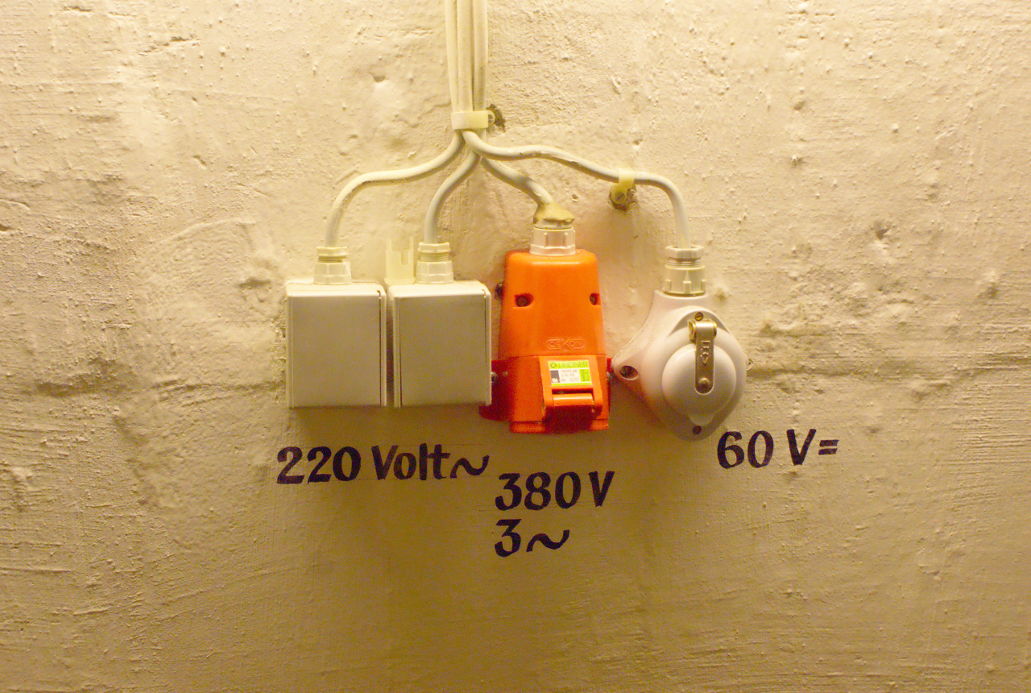
Image Source: https://flic.kr/p/73eSV7

Slide 4
What are Microservices?
Small, autonomous services working together
Single responsibility principle applied to SOA
See also concept of Bounded Context
Best used with DevOps and continuous deployment
Enhance cohesion, decrease coupling, enable incremental evolvement
How small are Microservices?
It depends (e.g. team structure, DevOps maturity, etc.)
“… one agile team can build and run it”, “… can be rebuilt by a small team in two weeks”
Find an individual balance
Autonomous = deploy changes without affecting others
Technology- and platform-agnostic APIs
See also https://en.wikipedia.org/wiki/Microservices

Slide 5
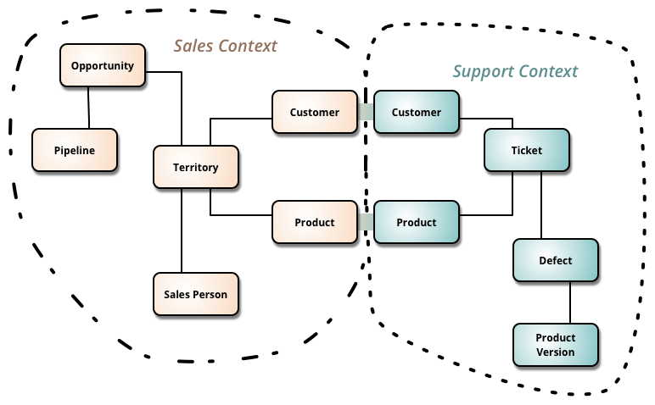
Microservices
Source: http://martinfowler.com/bliki/BoundedContext.html

Slide 6
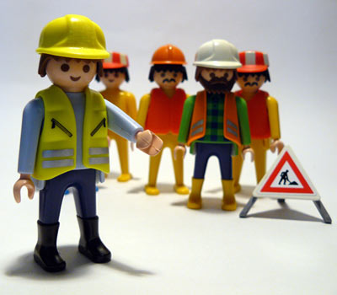
Autonomous Teams
Image Source: https://flic.kr/p/4JGGFW

Slide 7
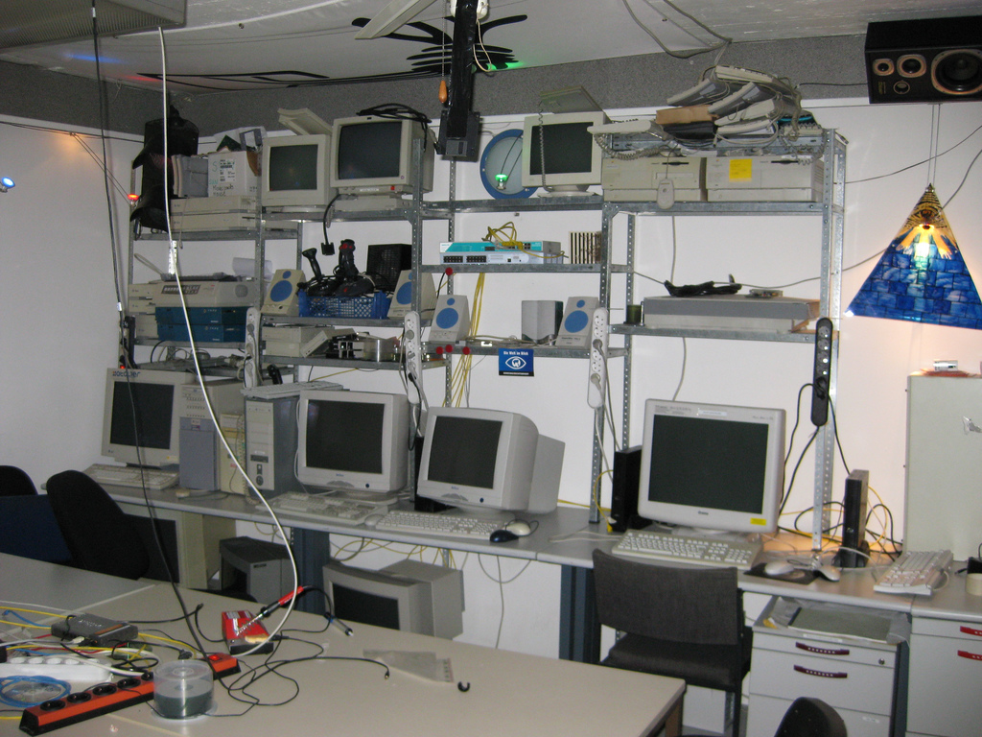
Image Source: https://flic.kr/p/5VB88j

Slide 8

Image Source: https://flic.kr/p/65RcDT

Slide 9

Image Source: https://flic.kr/p/5qtj4r

Slide 10
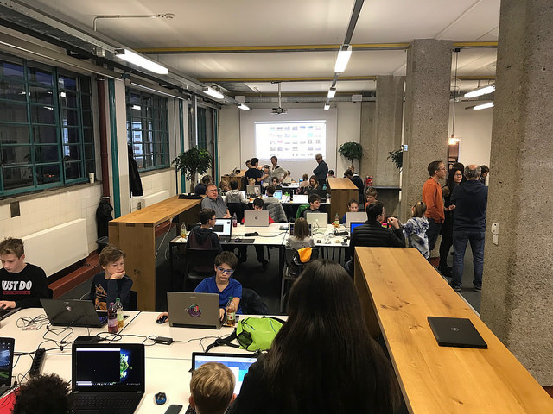


Slide 11
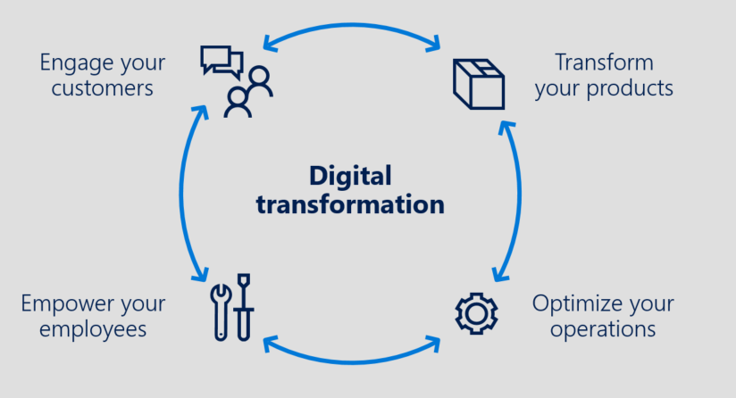
From IaaS to … Innovation with PaaS
Advanced Analytics & Big Data, IoT, App Innovation / Intelligent Apps / Serverless …
PaaS
DIFFERENTIATION
VALUE TO BUSINESS
Storage, Back-up & DR
INNOVATION
APPLICATIONS AND SERVICES
Compute & Networking
EFFICIENCY
IaaS
TIME

Slide 12
Why Not?

Slide 13

Trust is Required
Image Source: https://flic.kr/p/9nWs1

Slide 14
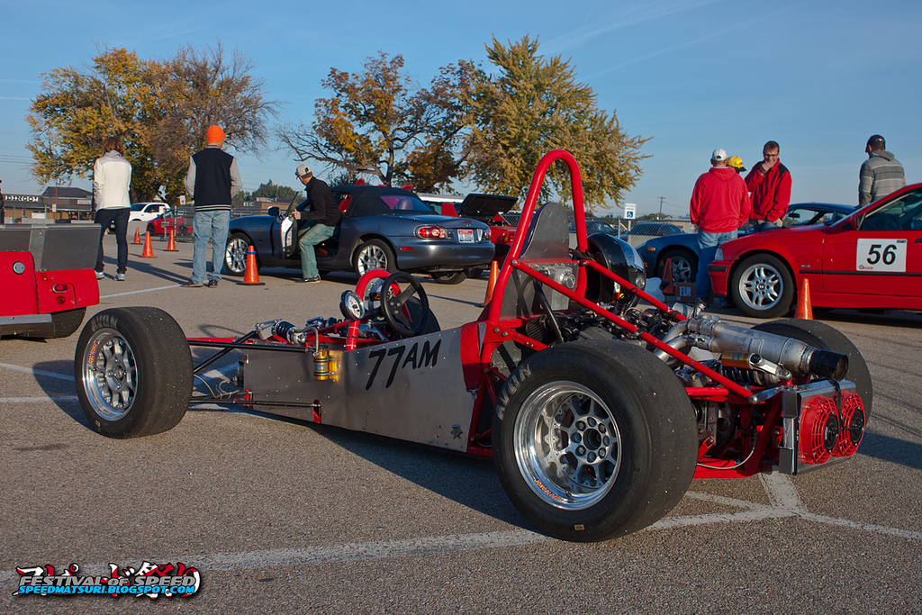
Specific Needs
Image Source: https://flic.kr/p/gWCWqU

Slide 15
Demo

Slide 16
C# Function
using System.Net;
public static async Task<HttpResponseMessage> Run(HttpRequestMessage req, TraceWriter log) {
log.Info("Received Tic-Tac-Toe request");
var board = await req.Content.ReadAsAsync<string[]>();
if (board.Length != 9) {
return req.CreateResponse(HttpStatusCode.BadRequest, "No valid tic-tac-toe board");
}
for(var row = 0; row < 3; row ++) {
if (!string.IsNullOrWhiteSpace(board[row * 3])
&& board[row * 3] == board[row * 3 + 1] && board[row * 3] == board[row * 3 + 2]) {
return BuildResponse(req, board[row * 3]);
}
}
for(var column = 0; column < 3; column ++) {
if (!string.IsNullOrWhiteSpace(board[column])
&& board[column] == board[3 + column] && board[column] == board[2 * 3 + column]) {
return BuildResponse(req, board[column]);
}
}
if (!string.IsNullOrWhiteSpace(board[0])
&& board[0] == board[3 + 1] && board[0] == board[2 * 3 + 2]) {
return BuildResponse(req, board[0]);
}
if (!string.IsNullOrWhiteSpace(board[2])
&& board[2] == board[3 + 1] && board[2] == board[2 * 3]) {
return BuildResponse(req, board[1]);
}
return BuildResponse(req);
}
private static HttpResponseMessage BuildResponse(HttpRequestMessage req, string winner = null)
=> req.CreateResponse(HttpStatusCode.OK, new { winner = winner });
TicTacToe Logic
Create Function App
Consumption Plan
Application Insights integration
Create in Portal
Call via HTTP (Insomnia)
Show background files
C# Scripts
JSON configuration files

Slide 17
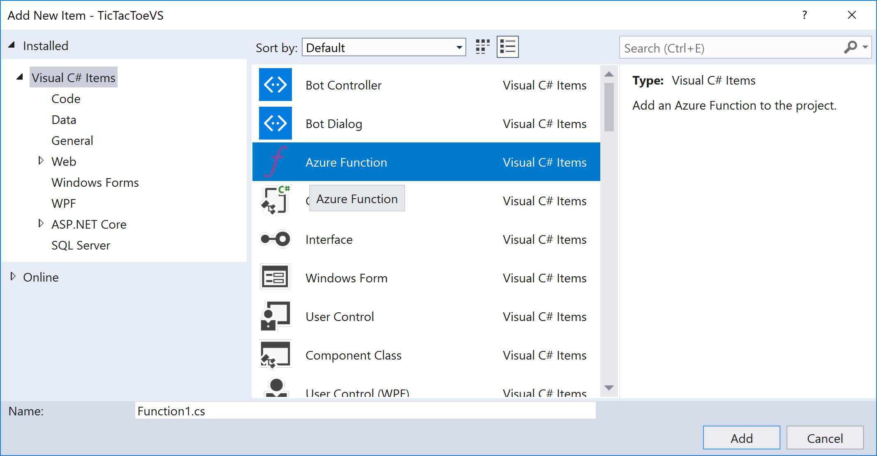
C# Function
Develop in Visual Studio
Create Function App
Visual Studio
Debugging with VS
Deploy using VS

Slide 18
Node.js Function
func init --no-source-control
func templates list
func new
-> Answer wizard questions (Node.js)
func start
Local Development
Create Function App
Node.js
Call via HTTP (Insomnia)

Slide 19
Node Function
module.exports = function (context, req) {
// Parse request body
var board = JSON.parse(req.body);
// Make sure that body is a properly formed array
if (Array.isArray(board) && board.length == 9) {
// Body is ok -> send message to trigger analysis
context.bindings.outputSbMsg = { Message: board };
// Send OK result to caller
context.res = { status: 202 };
context.done();
}
else {
// Body is malformed -> send Bad Request to caller
context.res = { status: 400, body: "No valid tic-tac-toe board" };
context.done();
}
};
TicTacToe Validator
Create Queue Binding
Call via HTTP (Insomnia)

Slide 20
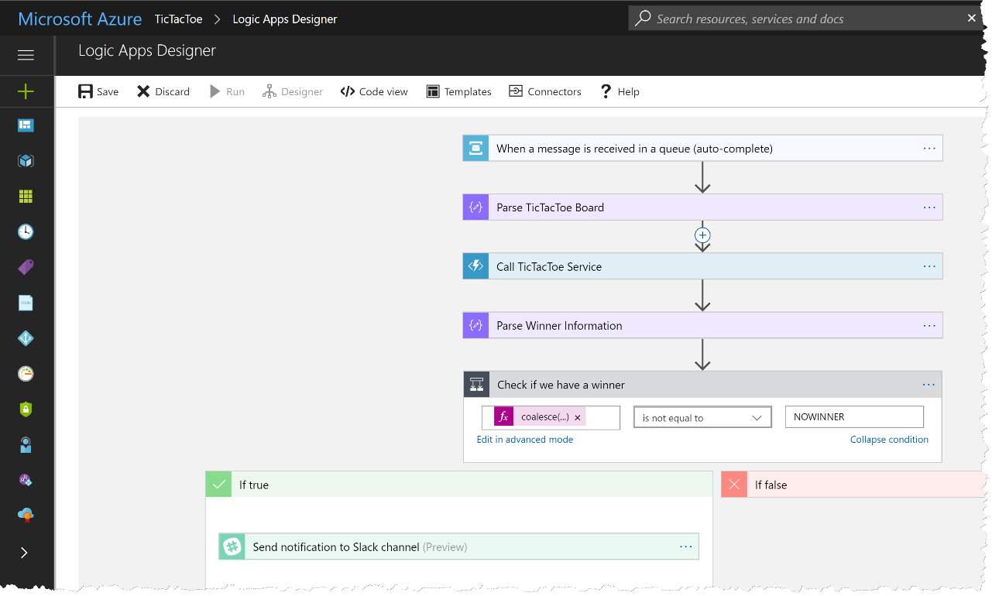
Logic App
Combine Functions with Workflows
Create function
Connect with Service Bus
Views
Design View
Code View

Slide 21
Logic App
"triggers": {
"When_a_message_is_received_in_a_queue_(auto-complete)": {
"inputs": {
"host": {
"connection": {
"name": "@parameters('$connections')['servicebus']['connectionId‘]“
}
},
"method": "get",
"path": "/@{encodeURIComponent(encodeURIComponent('tictactoe-request'))}/messages/head",
"queries": {
"queueType": "Main"
}
},
"recurrence": {
"frequency": "Second",
"interval": 15
},
"type": "ApiConnection"
}
}
TicTacToe Validator

Slide 22
Logic App
"Parse_TicTacToe_Board":{
"inputs":{
"content":"@base64toString(triggerBody()?['ContentData'])",
"schema":{
"properties":{
"Message":{
"items":{
"type":"string"
},
"type":"array"
}
},
"type":"object"
}
},
"runAfter":{
},
"type":"ParseJson"
}
TicTacToe Validator

Slide 23
Logic App
"Call_TicTacToe_Service":{
"inputs":{
"body":"@body('Parse_TicTacToe_Board')?['Message']",
"function":{
"id":"/subscriptions/26400a43-e689-48df-95dc-0b173a362cff/resourceGroups/serverless-hagenberg/providers/Microsoft.Web/sites/serverless-demo-func/functions/TicTacToe"
},
"headers":{
"x-functions-key":"zV6jby5icU3PaAx0...JgbOYef12Cqh3qD3zrvC/Q=="
},
"method":"POST"
},
"runAfter":{
"Parse_TicTacToe_Board":[
"Succeeded"
]
},
"type":"Function"
}
TicTacToe Validator

Slide 24
Logic App
"Parse_Winner_Information":{
"inputs":{
"content":"@body('Call_TicTacToe_Service')",
"schema":{
"properties":{
"winner":{
"type":"string"
}
},
"type":"object"
}
},
"runAfter":{
"Call_TicTacToe_Service":[
"Succeeded"
]
},
"type":"ParseJson"
}
TicTacToe Validator

Slide 25
Logic App
"Check_if_we_have_a_winner":{
"actions":{
"Send_notification_to_Slack_channel":{
"inputs":{
"host":{
"connection":{
"name":"@parameters('$connections')['slack']['connectionId']"
}
},
"method":"post",
"path":"/chat.postMessage",
"queries":{
"channel":"C02FJAB8J",
"text":"@{body('Parse_Winner_Information')?['winner']} is the winner"
}
},
"runAfter":{
},
"type":"ApiConnection"
}
},
"expression":"@not(equals(coalesce(body('Parse_Winner_Information')?['winner'], 'NOWINNER'), 'NOWINNER'))",
"runAfter":{
"Parse_Winner_Information":[
"Succeeded"
]
},
"type":"If"
}
TicTacToe Validator

Slide 26
What Else?

Slide 27
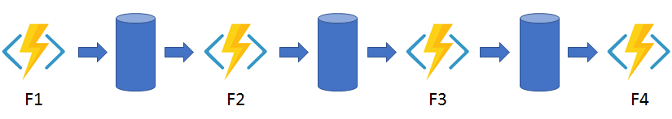
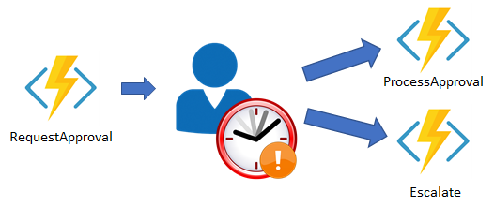
Durable Functions (Preview)
Function Chaining
Human Interaction
https://docs.microsoft.com/en-us/azure/azure-functions/durable-functions-overview

Slide 28
Summary

Slide 29
Image Source: https://flic.kr/p/73eSV7

Slide 30
Q&A
Strom kommt aus der Steckdose und IT aus der Cloud
Rainer Stropek
software architects gmbh
Mail Web Twitter
rainer@timecockpit.com http://www.timecockpit.com @rstropek
Thank your for coming!

